Slide 1
Project 1: Data Analysis of Singapore’s Rainfall and its influence on Singapore’s Seafood Trade
Kenneth Lim

Slide 2
Table of Contents
THE PARTS
01
Problem Statement
02
Research Objective
03
Technical Analysis
04
Recommendations

Slide 3
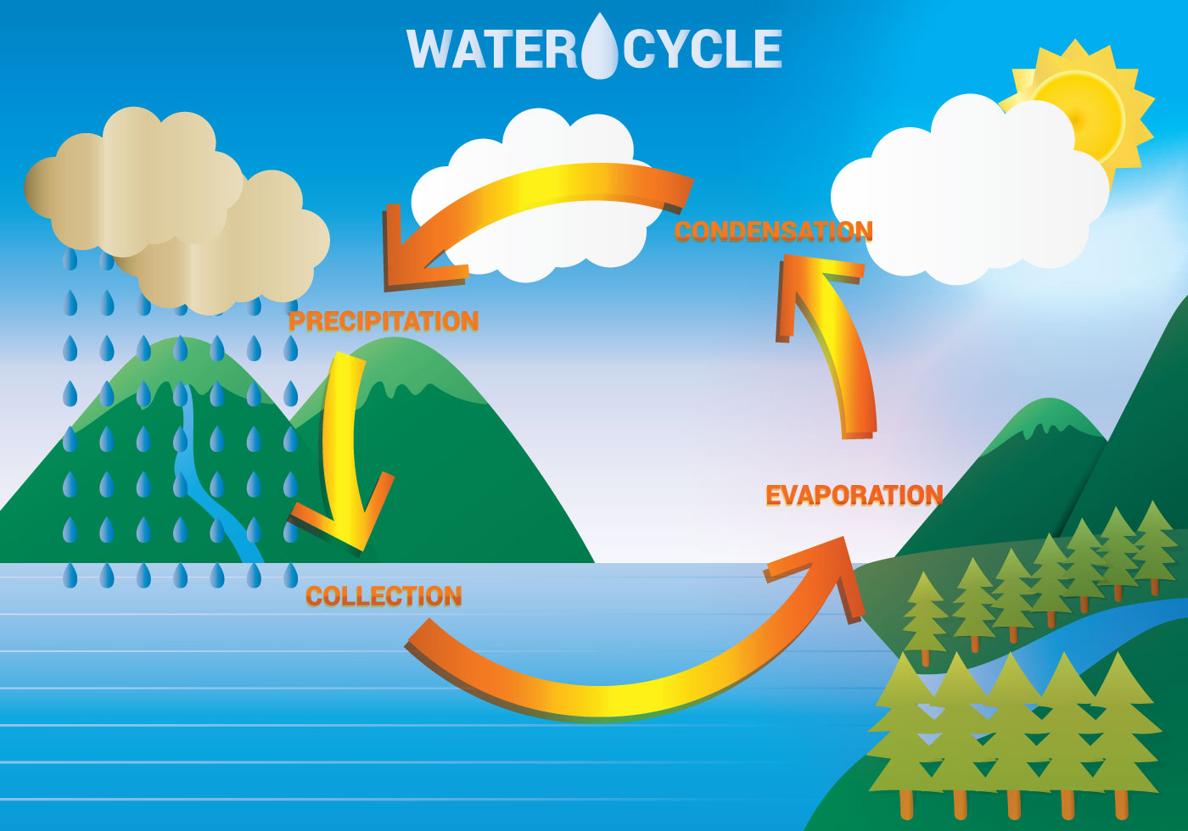

Slide 4
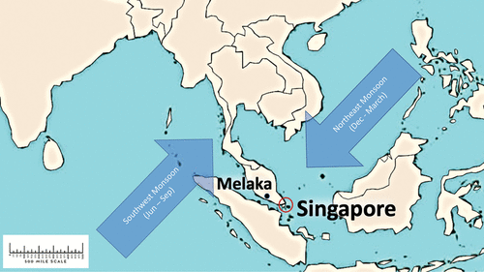
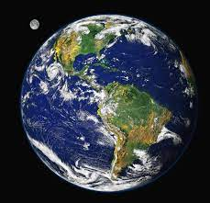
Background
Singapore is a tropical climate with abundant rainfall year round
Proximity to the equator gives features such as high temperature, high humidity
2 Monsoon seasons: Northeast Monsoon, Southeast Monsoon
Data Analyst employed by Singapore Food Agency

Slide 5
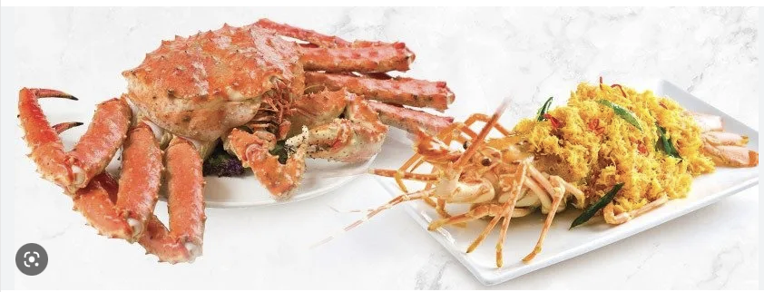
Problem Statement
How does Singapore’s weather parameters affect the overall seafood supply in the market?

Slide 6
Research Findings
More than 90% of Singapore’s food reserved are imported.

Slide 7
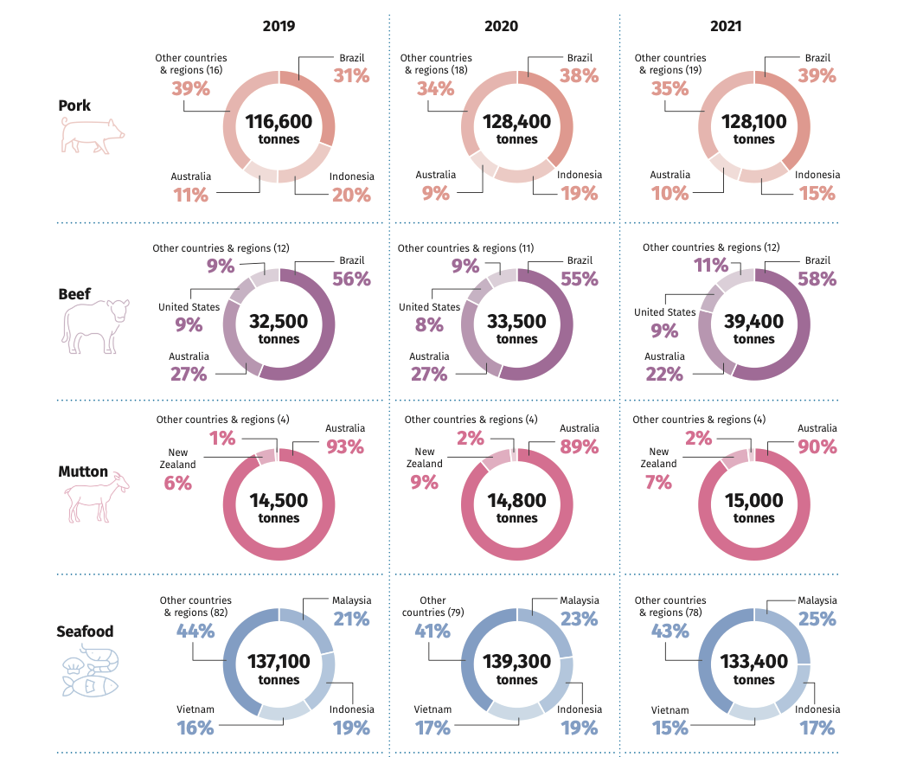
Source: https://www.sfa.gov.sg/docs/default-source/publication/sg-food-statistics/singapore-food-statistics-2021.pdf

Slide 8
Technical Analysis

Slide 9
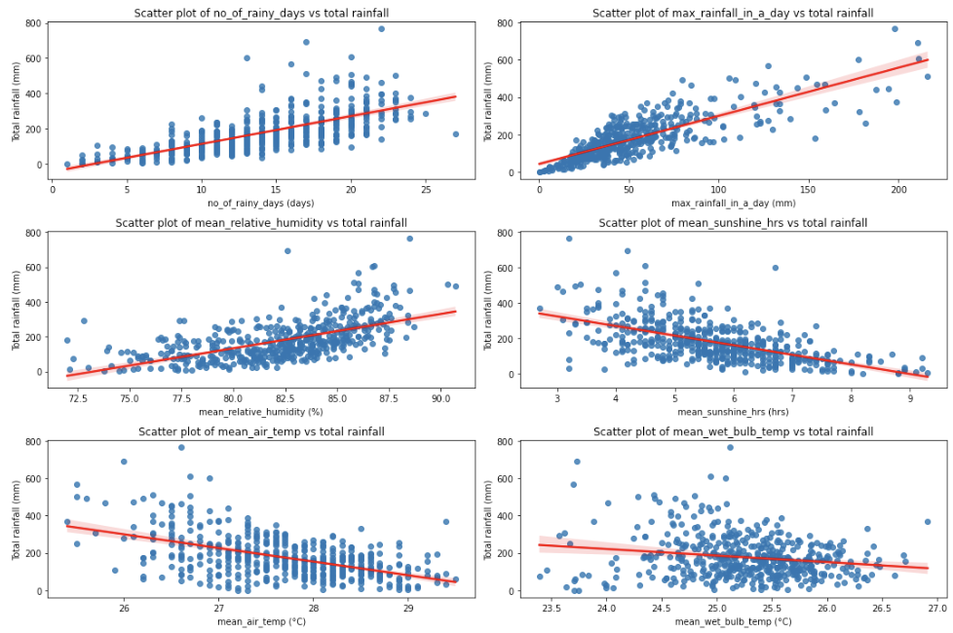
Analysis Trends of Total Rainfall & other Rainfall related parameters
Higher relative humidity -> More rainfall
Higher sunshine hours -> Less rainfall

Slide 10
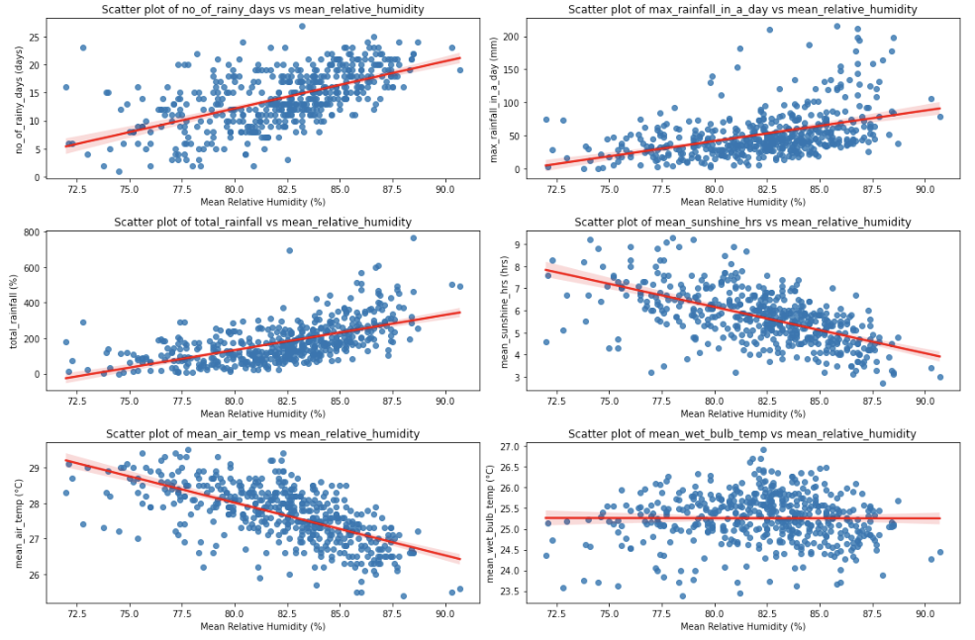
Analysis Trends of Relative Humidity & other Rainfall related parameters
Higher relative humidity -> More rainfall
Higher relative humidity -> Lesser sunshine
Higher relative humidity -> Lesser rainy days

Slide 11
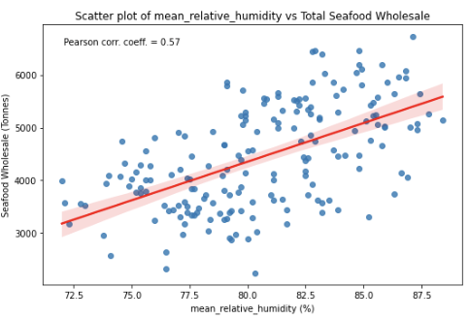
Analysis Trends of Relative Humidity & Total Seafood Wholesale
Higher relative humidity -> More Seafood catches from the ocean
?

Slide 12
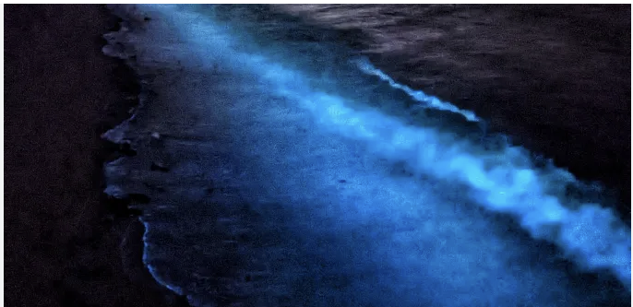
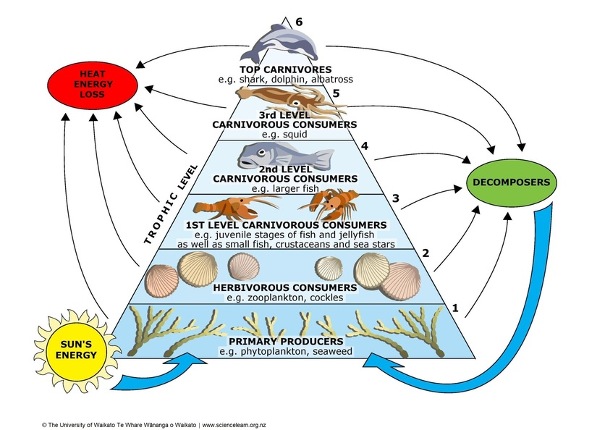
The Marine Food Chain
Tiny microorganisms in the oceans that are generate their own energy using CO2 and sunlight
Notes:
Phytoplankton are from a similar family to

Slide 13
Recommendations
First level | Second level | Final level
Quantify the relationship of other weather related variables E.g. Atmospheric Pressure, Wind Speed, Cloud Cover | Incorporate Pollutant/Environmental Metrics E.g. CO2, Methane emissions | Quantify relationship between sales of seafood sub-types Relationship between seafood prices with weather variables
Weather | Environment | Economic

Slide 14
Conclusion

Slide 15
Thank You

Slide 16
Sources
1. IPCC Sixth Assessment Report 2022: Chapter 10: Asia. In Climate Change 2022: Impacts, Adaptation and Vulnerability
2. A sustainable food system for Singapore and beyond, SFA Singapore, 11 Nov 2022:
https://www.sfa.gov.sg/food-for-thought/article/detail/a-sustainable-food-system-for-singapore-and-beyond
3. IN FOCUS: How climate change can threaten food production in Singapore, CNA Singapore, 19 Dec 2020:
https://www.channelnewsasia.com/singapore/climate-change-singapore-food-production-fish-eggs-1340266
4. Enhanced phytoplankton bloom triggered by atmospheric high-pressure systems over the Northern Arabian Sea, Prasad G.Thoppil, 14 Jan 2023: https://www.nature.com/articles/s41598-023-27785-z
5. Climate change effects on aquaculture production, Global Seafood Alliance, 20 Sept 2021: https://www.globalseafood.org/advocate/climate-change-effects-on-aquaculture-production/
6. Climate of Singapore: http://www.weather.gov.sg/climate-climate-of-singapore/
7. National Geographic: Hydrologic Cycle: https://education.nationalgeographic.org/resource/hydrologic-cycle
8. What are Phytoplankton? NASA Earth Observatory: https://earthobservatory.nasa.gov/features/Phytoplankton

